Slide 1

Smart Campus – Classroom Occupancy Detection
Supervisor: Mayya Lihovodov
Students:
Shira Vainer 206533184
Menalu chekol 328858071
Trngo Abawa 332565050
Zohar Shalom 212512032

Slide 2
Background & Goal
Benefits:
Problem
Save energy
classrooms waste energy when empty
Support sustainability
Goal
Improve space management
predict occupancy in real time using sensors
Better student/faculty experience

Slide 3

Dataset
Sensors
Collection Period
Temperature, Humidity, CO₂, Light
Collected over several weeks in classrooms
Class Imbalance
77% unoccupied vs 23% occupied
Data reflects human presence (CO₂ + Light rise when occupied)

Slide 4




Exploratory Data Analysis
Compared distributions: occupied vs unoccupied
Findings:
Light = strongest predictor
CO₂ = reliable secondary indicator
Temperature = slight increase
Humidity = minimal effect

Slide 5
Correlation Analysis
0.91
0.56
0.50
0.05
Light
Temperature
CO₂
Humidity
(very strong)
(moderate)
(weak)
(moderate)
Conclusion: Light + CO₂ dominate

Slide 6
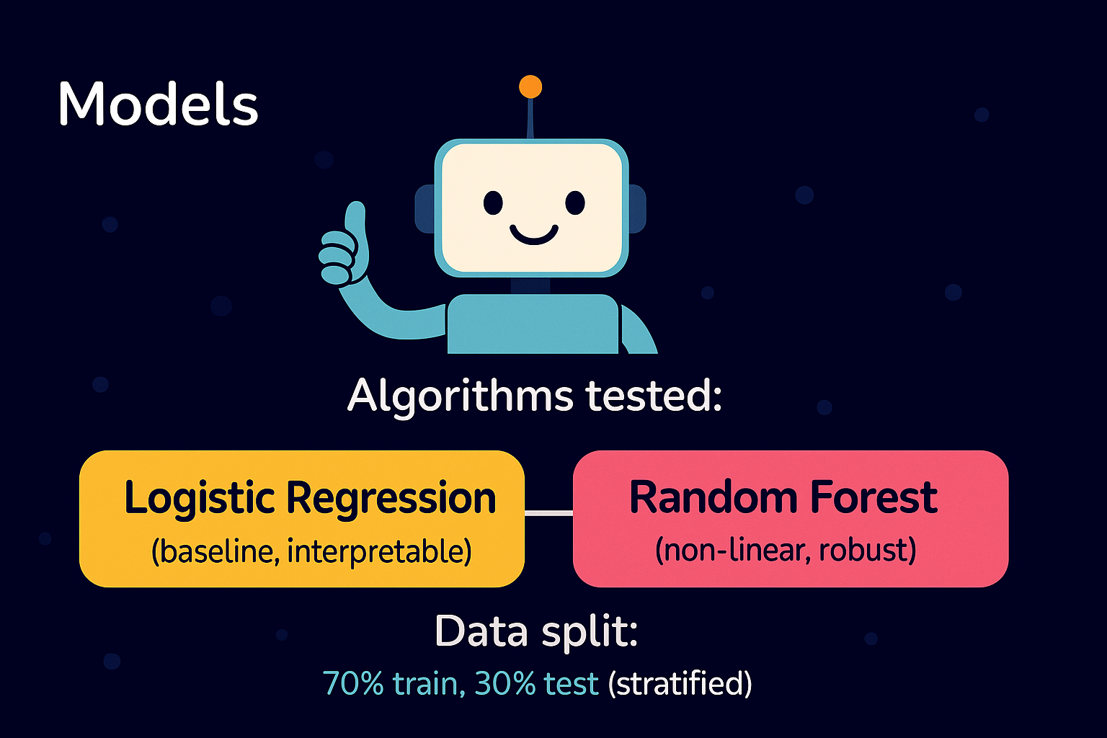
(non-linear, robust)

Slide 7
Results
Model
Accuracy
F1 Score
Logistic Regression
98.8%
0.974
Random Forest
99.1%
0.982
Performance
Error Analysis
Both models performed almost perfectly
Confusion Matrix shows few errors

Slide 8
Model Comparison
Logistic Regression
Random Forest
simpler, transparent
slightly higher accuracy
Random Forest
Conclusion
stronger predictive power

Slide 9
Limitations
1
2
Scope
Environmental Factors
Data from a single classroom
HVAC, windows, lights left on
3
4
Model Coverage
Data Quality
Only two models tested
Possible sensor noise or calibration issues

Slide 10




Conclusions & Future Work
Key Predictors
Baseline Model
Light + CO₂ = strongest predictors
Logistic Regression = robust baseline
Best Performance
Best Performance
Random Forest = maximum performance (~99%)
Random Forest = maximum performance (~99%)

